Slide 1

Responsible AI Discussions

Slide 2
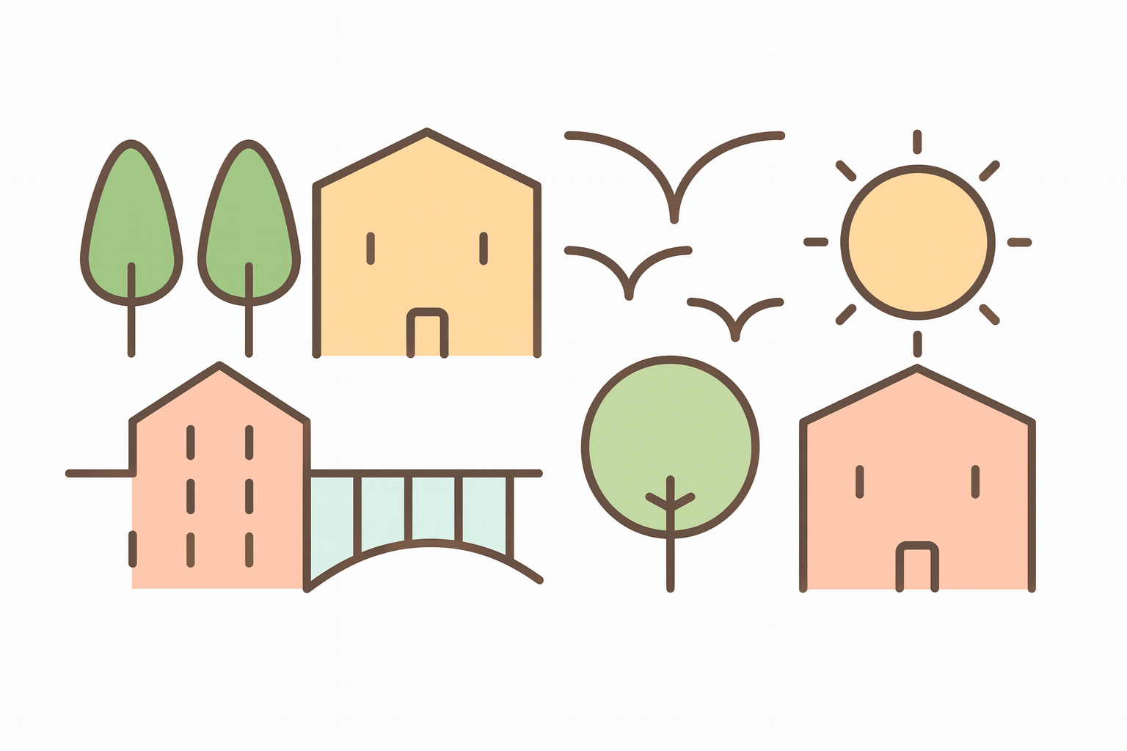
Responsible AI

Slide 3
90%
Responsible AI

Slide 4
